Slide 1
MACHINE revenue | In USD
Sales | 140,000
Warranty | 50,000
Maintenance | -50,000
Repairs | -45,000
Operating costs | -7,000

Slide 2
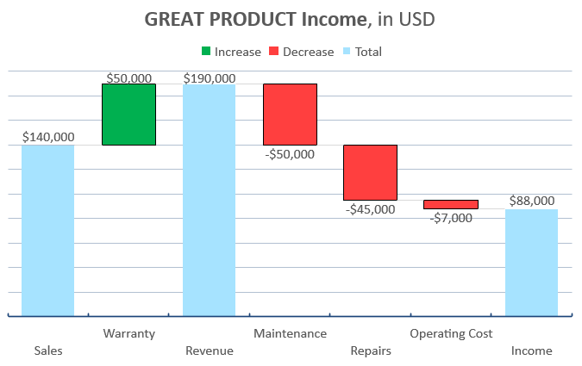
Exercise: Waterfall with 2 totals

Slide 3
1. Add a Waterfall Chart
2. Add Income and Revenue columns. Tell PowerPoint about it and clear totals
3. Use green for increase and red for decrease
4. Use data labels and remove axis

